Slide 1
Module 11: Redux II
SER 423

Slide 2
Overview
Last time we look at the struggles we face when trying to store the state of the app
We then looked at all the pieces of how Redux works
This time we are going to focus on the implementation of Redux
This set of slides will mostly be breaking down code since we covered the high level discussion last time
  There’s a lot to look at here
We’ll start with the Actions
Then look at the Reducers
And finally look at the actual store itself

Slide 3
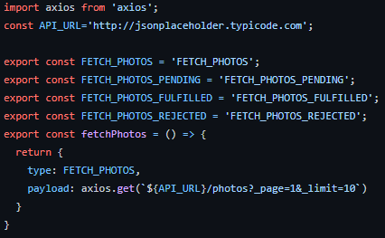
Defining the Actions

Slide 4
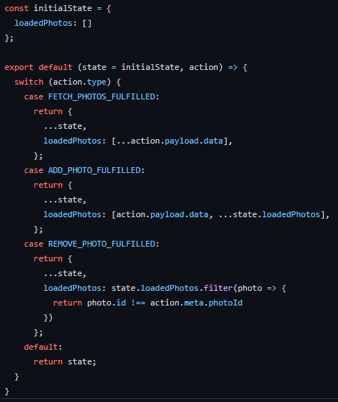
Defining the Reducer

Slide 5
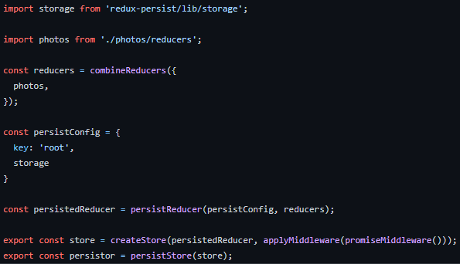
Making the Actual Store

Slide 6
End of Redux II
That’s all for Module 11!

